Slide 1
Lecture 06
PoW and PoS

Slide 2
Roadmap
Centralized and decentralized systems
Distributed Consensus
Consensus problem in Bitcoin
Bitcoin Consensus Algorithm
  Incentives for miners, Proof of work, Limitations

Slide 3
Centralization vs. Decentralization
Competing paradigms that underlie many digital technologies
Decentralized and Distributed Systems?

Slide 4
Aspects of decentralization in Bitcoin
Who maintains the ledger?
Who has authority over which transactions are valid?
Who creates new bitcoins?
Who determines how the rules of the system change?
How do bitcoins acquire exchange value?

Slide 5
Roadmap
Centralized and decentralized systems
Distributed Consensus
Consensus problem in Bitcoin
Bitcoin Consensus Algorithm
  Incentives for miners, Proof of work , Limitations

Slide 6
Decentralization Challenges
A lot more when compared to a centralized system.
There is no global clock and an agreed upon notion of time.
So? Why does it matter?

Slide 7
The distributed consensus problem
The consensus problem in distributed systems is the problem of getting a set of nodes to agree on something
  it might be a value
  a course of action or a decision.
The protocol terminates and all correct nodes decide on the same value. This value must have been proposed by some correct node

Slide 8
Why consensus is hard
Nodes may crash
Nodes may be malicious
Network is imperfect
Not all pairs of nodes connected
Faults in network
Latency
No notion of global time
Notes:
Analogy of talking on the phone and having a lag

Slide 9
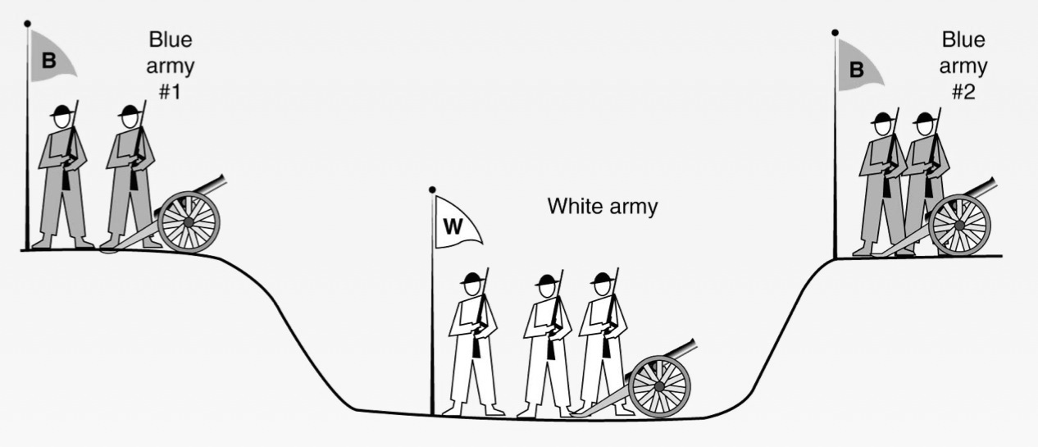
Two-Army (General’s) Problem

Slide 10
Two-Army (General’s) Problem
There is a famous problem that illustrates this issue. It is called the two-army problem
  if either blue army attacks by itself, it will be defeated, but if the two blue armies attack simultaneously, they will be victorious.
  Their only communication medium is to send messengers into the valley, where they might be captured and the message lost

Slide 11
Two-Army (General’s) Problem
It can be proven that no protocol to synchronize the attack exists neither of the two commanders can be certain that the other one has received the message
  First general: "Attack at 0900 on August 10."
  Second general: "I received your message and will attack at 0900 on August 10."
  First general: "I received your confirmation of the planned attack at 0900 on August 10. »
  ….

Slide 12
Byzantine General’s Problem
The Problem: “Several divisions of the Byzantine army are camped outside an enemy city, each division commanded by its own general. After observing the enemy, they must decide upon a common plan of action. Some of the generals may be traitors, trying to prevent the loyal generals from reaching agreement.”
Goal:
  All loyal generals decide upon the same plan of action.
  A small number of traitors cannot cause the loyal generals to adopt a bad plan.
The paper considers a slightly different version from the standpoint of one general (i.e., process) and multiple lieutenants.
Goal:
  All loyal lieutenants obey the same order.
  If the commanding general is loyal, every loyal lieutenant obeys the order he sends.
Lamport, Shostak, Pease. The Byzantine General’s Problem. ACM TOPLAS, 4,3, July 1982, 382-401.

Slide 13
Impossibility Results
General 1
General 1
attack
attack
attack
retreat
General 2
General 3
General 2
General 3
retreat
retreat
No solution for three processes can handle a single traitor.
In a system with m faulty processes agreement can be achieved only if there are 2m+1 (more than 2/3) functioning correctly.
Lamport, Shostak, Pease. The Byzantine General’s Problem. ACM TOPLAS, 4,3, July 1982, 382-401.
Notes:
The resilience of BFT is optimal: at least 3 f + 1 replicas are necessary to provide the safety and liveness properties under our assumptions when up to f replicas are faulty. To understand the bound on the number of faulty replicas, consider a replicated service that implements a mutable variable with read and write operations. To provide liveness, the service may have to return a reply before the request is received by more than n− f replicas, since f replicas might be faulty and not responding. Therefore, the service may reply to a write request after the new value is written only to a set W with n − f replicas. If later a client issues a read request, it may receive a reply based on the state of a set R with n− f replicas. R and W may have only n−2 f replicas in common. Additionally, it is possible that the f replicas that did not respond are not faulty and, therefore, f of those that responded might be faulty. As a result, the intersection between R and W may contain only n − 3 f nonfaulty replicas. It is impossible to ensure that the read returns the correct value unless R and
W have at least one nonfaulty replica in common; therefore n > 3 f .

Slide 14
Some well-known protocols
Example: Paxos/RAFT
Never produces inconsistent result, but can (rarely) get stuck
CAP Theorem
Notes:
Paxos and Raft are two well-known consensus algorithms used in distributed computing to ensure that a group of nodes or servers can agree on a consistent state or decision despite failures and network partitions. Both algorithms aim to solve the consensus problem, but they do so with different approaches and trade-offs. Here's an overview of Paxos and Raft:
**Paxos:**
1. **Introduction:** Paxos is one of the earliest consensus algorithms, introduced by Leslie Lamport in 1989. It is known for its mathematical rigor and has been the basis for many distributed systems and databases.
2. **Complexity:** Paxos is often considered complex and can be challenging to understand and implement correctly. It's known for its various phases, including Phase 1 (Prepare), Phase 2 (Accept), and Phase 3 (Learn).
3. **Scalability:** While Paxos is a robust consensus algorithm, it can become complex to manage in larger clusters due to its message complexity and the need for multiple rounds of communication.
4. **Liveness:** Paxos guarantees safety, meaning it ensures that no conflicting decisions are made. However, it does not guarantee liveness, which means it may not always reach a decision if there are persistent failures or network partitions.
**Raft:**
1. **Introduction:** Raft is a newer consensus algorithm introduced by Diego Ongaro and John Ousterhout in 2013. It was designed to be more understandable and easier to implement compared to Paxos.
2. **Simplicity:** Raft is praised for its simplicity and clarity. It uses a leader-follower approach, where one node (the leader) is responsible for coordinating the consensus process, making it easier to reason about.
3. **Scalability:** Raft is considered more scalable and easier to manage in larger clusters compared to Paxos. Its leader-follower model simplifies communication.
4. **Liveness:** Raft prioritizes liveness over safety. It ensures that the system continues to make progress (liveness) even if it means possibly making conflicting decisions under certain conditions. However, it still guarantees safety under normal conditions.
**Comparison:**
- Paxos is often regarded as more complex and challenging to implement correctly, whereas Raft is designed for simplicity and ease of understanding.
- Raft is generally considered more suitable for educational purposes and practical implementations in distributed systems, while Paxos is more theoretical.
- Paxos has been widely used in real-world systems, while Raft gained popularity due to its simplicity and ease of adoption.
In summary, both Paxos and Raft are consensus algorithms that aim to solve the same problem but take different approaches. Raft is often preferred for its simplicity and understandability, making it a popular choice for building distributed systems, while Paxos has a longer history and has been used extensively in various applications. The choice between them depends on the specific requirements and complexity of the distributed system being designed.

Slide 15
Roadmap
Centralized and decentralized systems
Distributed Consensus
Consensus problem in Bitcoin
Bitcoin Consensus Algorithm
  Incentives for miners, Proof of work , Limitations

Slide 16
Consensus is Impossible?
Byzantine generals problem, 3f+1
Fischer-Lynch-Paterson (deterministic nodes): consensus impossible with a single faulty node
Notes:
The Fischer-Lynch-Paterson (FLP) impossibility result is a fundamental theorem in distributed computing that demonstrates the impossibility of achieving consensus in a distributed system when there is even a single faulty (Byzantine) node in an asynchronous network. This result was first proven by Fischer, Lynch, and Paterson in their 1985 paper titled "Impossibility of Distributed Consensus with One Faulty Process."
Here's a simplified explanation of the FLP impossibility result:
1. **Consensus Problem:** Consensus is a fundamental problem in distributed computing, where a group of nodes in a network must agree on a single value or decision among multiple proposed values. The goal is for all correct nodes to eventually reach the same decision.
2. **Byzantine Faults:** In the FLP theorem, the focus is on Byzantine faults, which are the most challenging type of faults in distributed systems. A Byzantine node can behave arbitrarily, including sending incorrect or conflicting information to other nodes.
3. **Asynchronous Network:** The FLP theorem assumes an asynchronous network, where there are no bounds on message delivery times, and nodes may experience arbitrary delays.
The FLP theorem proves that, in an asynchronous network with at least one faulty (Byzantine) node, there is no deterministic algorithm that can guarantee consensus, regardless of the time taken for message delivery or the behavior of the nodes.
In simpler terms, even with perfect communication and the ability to wait indefinitely for messages, it is impossible to ensure that all nodes agree on a common value if there is even one Byzantine node in the system.
To work around this impossibility result, distributed systems often employ various strategies and heuristics, such as introducing redundancy, using probabilistic algorithms, or assuming bounds on message delays. These approaches can improve the practical likelihood of achieving consensus in the presence of faults, even though deterministic algorithms cannot provide a guarantee in the worst-case scenario described by the FLP theorem.

Slide 17
Bitcoin consensus: theory & practice
Bitcoin consensus works better in practice than in theory
Theory is still catching up
BUT theory is important, can help predict unforeseen attacks

Slide 18
Some things Bitcoin does differently
Introduces incentives
  Possible only because it’s a currency!
Embraces randomness
  Does away with the notion of a specific end-point
  Consensus happens over long time scales — about 1 hour

Slide 19
Some things Bitcoin does differently
Bitcoin nodes dont have identity
  Pseudonymity is a goal of Bitcoin
  Implications?

Slide 20
Roadmap
Centralized and decentralized systems
Distributed Consensus
Consensus problem in Bitcoin
Bitcoin Consensus Algorithm
  Incentives for miners, Proof of work , Limitations

Slide 21
Consensus algorithm (simplified)
New transactions are broadcast to all nodes
Each node collects new transactions into a block
In each round a random node gets to broadcast its block
Other nodes accept the block only if all transactions in it are valid (unspent, valid signatures)
Nodes express their acceptance of the block by including its hash in the next block they create

Slide 22
Roadmap
Centralized and decentralized systems
Distributed Consensus
Consensus problem in Bitcoin
Bitcoin Consensus Algorithm
  Incentives for miners, Proof of work , Limitations

Slide 23
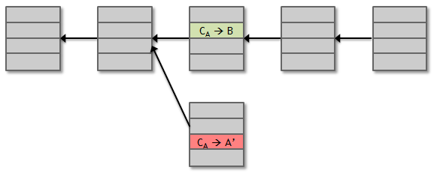
Assumption of honesty is problematic
Can we give nodes incentives for behaving honestly?
Everything so far is just a distributed consensus protocol
But now we utilize the fact that the currency has value
Can we reward nodes
that created these blocks?
Can we penalize the node
that created this block?

Slide 24
Incentive 1: block reward
Creator of block gets to
include special coin-creation transaction in the block
choose recipient address of this transaction
Value is fixed: currently 6.25 BTC, halves every 4 years
Block creator gets to “collect” the reward only if the block ends up on long-term consensus branch!

Slide 25
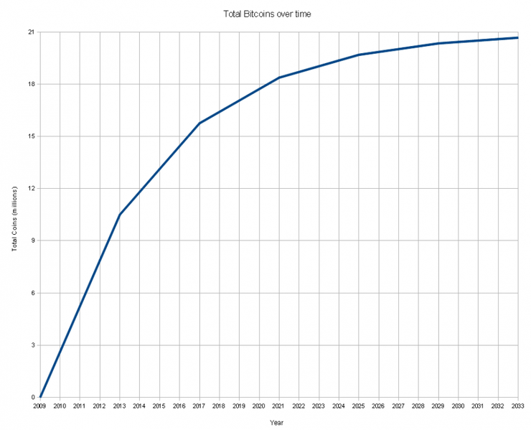
There’s a finite supply of bitcoins
Total supply: 21 millions
Block reward is how
new bitcoins are created
Runs out in 2040. No new bitcoins unless rules change
Total bitcoins in circulation
First inflection point:
reward halved from 50BTC to 25BTC
Year

Slide 26
Incentive 2: transaction fees
Creator of transaction can choose to make
output value less than input value
Remainder is a transaction fee and goes to block creator
Purely voluntary, like a tip

Slide 27
Roadmap
Centralized and decentralized systems
Distributed Consensus
Consensus problem in Bitcoin
Bitcoin Consensus Algorithm
  Incentives for miners, Proof of work, Limitations

Slide 28
Proof of work
To approximate selecting a random node:
select nodes in proportion to a resource
that no one can monopolize (we hope)
In proportion to computing power: proof-of-work
In proportion to ownership: proof-of-stake

Slide 29
Equivalent views of proof of work
Select nodes in proportion to computing power
Let nodes compete for right to create block
Make it moderately hard to create new identities

Slide 30
Hash puzzles
nonce
prev_h
Tx
To create block, find nonce such that
H(nonce ‖ prev_hash …) is very small
Tx
Output space of hash
Target
space
If hash function is secure:
only way to succeed is to try enough nonces until you get lucky
Notes:
If Alice has 100x more computing power than Bob it doesn’t mean she always wins the race. It means she has about a 99% chance of wining. In the long run Bob will create 1% of the blocks

Slide 31
PoW property 1: difficult to compute
As of Aug 2014: about 10²⁰ hashes/block
Only some nodes bother to compete — miners

Slide 32
PoW property 2: parameterizable cost
Nodes automatically re-calculate the target every two weeks
Goal: average time between blocks = 10 minutes
Prob (Alice wins next block) =
fraction of global hash power she controls
Notes:
what happens if time b/w blocks is too low or too high. 2016

Slide 33
PoW property 3: trivial to verify
Nonce must be published as part of block
Other miners simply verify that
H(nonce ‖ prev_hash ‖ … ) < target
Notes:
This is quite an important property, because, once again, it allows us to get rid of centralization. We don’t need any centralized authority verifying that miners are doing their job correctly. Any node or any miner can instantly verify that a block found by another miner satisfies this proof-of-work property.

Slide 34
Roadmap
Centralized and decentralized systems
Distributed Consensus
Consensus problem in Bitcoin
Bitcoin Consensus Algorithm
  Incentives for miners, Proof of work, Limitations

Slide 35
Key security assumption
Attacks infeasible if majority of miners weighted by hash power follow the protocol

Slide 36
From Bob the merchant’s point of view
1 confirmation
3 confirmations
C_{A} → B
Double-spend probability decreases exponentially with # of confirmations
Most common heuristic:
6 confirmations
C_{A} → A’
double-spend
attempt
Hear about C_{A} → B transaction
0 confirmations

Slide 37
What can a “51% attacker” do?
Steal coins from existing address?
Suppress some transactions?
From the block chain
From the P2P network
Change the block reward?
Destroy confidence in Bitcoin?

Slide 38
PoW Strengths
Proven applicability, predictable block times
Does not rely on any other node being trustworthy
Only known vulnerability is the so-called ‘51% attack’
Uncensorable and publicly broadcast
Notes:
Notes on public transactions: This refers to basic implementations of proof of work. There are other ways to obfuscate transaction parties and amounts present in many ‘privacy currencies’ today. See ZKsnarks (Zcash), Ring signatures and confidential transactions (Monero and dash), among others.
See for basic overview: https://steemit.com/money/@thecryptodrive/a-lesson-in-anonymity-bitcoin-dash-monero-and-zcash

Slide 39

PoW Drawbacks
Enormous waste of resources
  Bitcoin mining uses much energy as Argentina
ASIC hardware give advanced miners and mining pools a substantial advantage over the average miner
  Massive start up costs can result in centralization of pools and resources
  A regular computer has essentially no hope of ever mining a block

Slide 40
PoW Drawbacks
Mining pools are able to slightly game the system by delaying the release of a found block and gaining a slight head start on next one
Scalability issues
  Lower transaction throughput
  Lowering the block time (problem difficulty) is potentially less secure
Miners often sell the coins immediately, removing any loyalty to the chain they are mining

Slide 41




Current PoW Systems
Bitcoin
Ethereum (Casper)
Litecoin
Bitcoin Cash
Many, many more
Many systems launch with a Proof-of-Work-like consensus mechanism, but later transition to a different, less resource intensive approach, often with proprietary features

Slide 42
Do not distribute ...
These slides are not always prepared by me.
Most of the content comes from the reference book
  Bitcoin and Cryptocurrency Technologies: A Comprehensive Introduction
  Arvind Narayanan, Joseph Bonneau,
  Edward Felten, Andrew Miller, Steven Goldfeder

